Slide 1
Legislative Matters

Slide 2
Recording is governed only by RCW.
Therefore, changes are only accomplished when a bill becomes a law.
And clarification or correction requires another law, which requires another bill.
And the Legislature meets only a few months each year (thankfully).

Slide 3
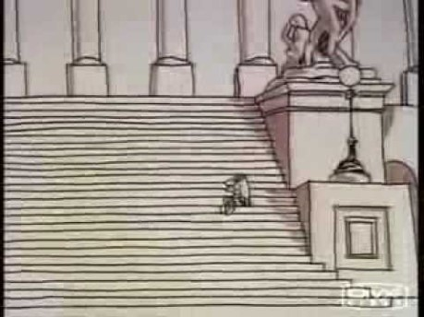
How the Legislative Process Works

Slide 4
How the Legislative Process Really Works
A frequent comment about the legislature is that it is the place that bills go to die.
Another comment is that there is no idea that can’t become a bill, no matter how bad.

Slide 5
What Passed
Which brings us to where we are now.
This Photo by Unknown Author is licensed under CC BY-SA-NC

Slide 6
Fee Changes
Some we had input
Library-Archives – SOS request bill
Public Records Admin – SOS
Some we didn’t
Urban Planning

Slide 7
IRS Fees
Purpose:
Clarify that federal liens are not subject to housing surcharges
A good little bill that got hijacked, then rescued
A lot of hard work by Rep Nicole Macri and a lot of other people

Slide 8
Remote Online Notarization
Purpose:
Authorize use of remote online notarization
It quietly moved through
Many states have passed a similar act
Thanks to prime sponsor Sen Jeff Holy

Slide 9
Vital Statistics
Purpose:
Update vital records collection, forms and retention based on national standards
Originally, marriage and death would have been sealed for over 50 years
Retention was removed after outcry from many stakeholders

Slide 10
Address Confidentiality Program
Purpose:
provide a method for ACP participants to buy and own real estate while protecting their information from public disclosure
Original required confidentiality of information
Final bill created workgroup to develop ideas
Expect a bill for the 2020 Legislative session

Slide 11
What Is Still Percolating
Housing Fees – housing is still a hot topic
Wage Liens –
Purpose: allow liens against assets of employers for unpaid wages
Original bill authorized recording liens against vehicles
Brought in DOL
Bill is stalled but likely to come back
ACP
DNR
Change from $64 per survey/map to $10 per every document

Slide 12
What do we want to pursue? Already exists
Marriage Bill
Eliminate 3 day waiting period
Auditor as officiant with fees to general fund
Authoritative Agency
Federal Lien Fees clean up – round 2

Slide 13
What do we want to pursue? Need to create
Predictable Recording Fees
Multi-title documents
Multi-transaction documents
Mandatory coversheet
List of indexing titles
Fee clean up
Eliminate $7 for veteran’s request
Change Employment Security ($36) to match other exempts ($39)

Slide 14
Questions?

Slide 15
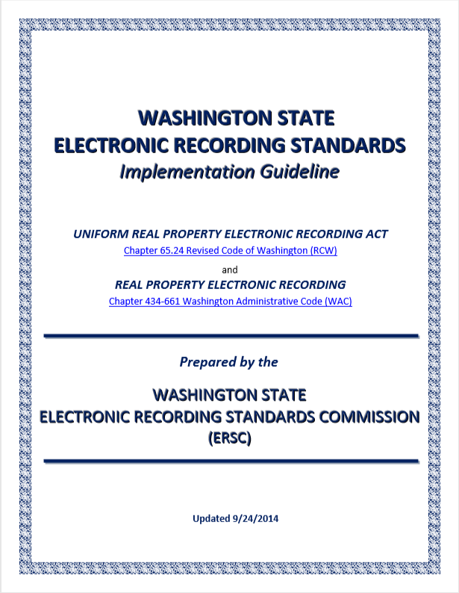
Addressing Past Legislation
Electronic Signature
Electronic Notarization

Slide 16
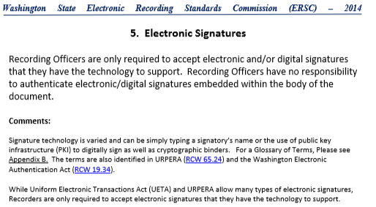
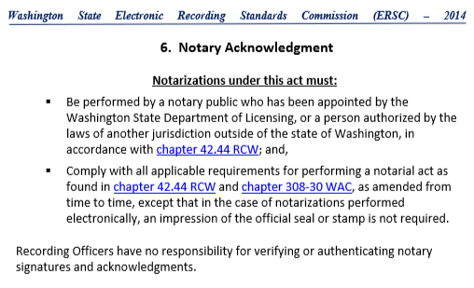
Applicable Standards

Slide 17
Applicable Standards
RCW 19.34 Washington Electronic Authentication Act
RCW 19.34.020
(14) "Electronic signature" means a signature in electronic form attached to or logically associated with an electronic record, including but not limited to a digital signature.
Questions?

Slide 18
Notice of Trustee Sale
Originally, the bill required that Recorders collect a $300 fee for each NOTS
Compromise is that we report NOTS details periodically to Dept of Commerce
Commerce has two goals:
Reconcile that the submitters have paid the proper fees to Commerce
Report activity and results to the Legislature annually
2019 was the initial reporting period
And the results are:

Slide 19
Results of NOTS Reporting
Reporting periods vary so difficult to reconcile with submitters
Indexing is still a challenge
Data format of county reports varies in format, accuracy and completeness

Slide 20
Issues to Address with NOTS Reporting
Recommended Reporting Periods
January thru June due by July 31
July thru December due by January 31
Action: approve recommended reporting periods

Slide 21
Issues to Address with NOTS Reporting
Indexing
Not all parties are being indexed
Layout of reports makes identifying beneficiary difficult

Slide 22
Issues to Address with NOTS Reporting
Grantor | Grantee
[CANTU, JUAN F, AZTEC FORECLOSURE CORPORATION OF WASHINGTON, WELLS FARGO BANK, NA, WELLS FARGO BANK, N A] | [PUBLIC, THE]
[JOHNSON, TERRANCE L., QUALITY LOAN SERVICE CORPORATION OF WASHINGTON, WILMINGTON TRUST, NATIONAL ASSOCIATION, FAY SERVICING, LLC] | [PUBLIC, THE]
[CRULL, GREGORY M, QUALITY LOAN SERVICE CORPORATION OF WASHINGTON, ALABAMA HOUSING FINANCE AUTHORITY, ALABAMA HOUSING FINANCE AUTHORITY] | [PUBLIC, THE]
[QUINN, MERLE F, QUALITY LOAN SERVICE CORPORATION OF WASHINGTON, JPMORGAN CHASE BANK, NATIONAL ASSOCIATION, JP MORGAN CHASE BANK, N A] | [PUBLIC, THE]
[ALVAREZ, BONIFACIO, MUNOZ, MARIA A. , QUALITY LOAN SERVICE CORPORATION OF WASHINGTON, U S BANK, N A, SELECT PORTFOLIO SERVICING, INC] | [PUBLIC, THE]
[CALZADILLAS, GEORGE S, CALZADILLAS, BEATRICE, QUALITY LOAN SERVICE CORP OF WASHINGTON, BANK OF AMERICA, N A , REVERSE MORTGAGE SOLUTIONS, INC] | [PUBLIC, THE]
[BARNES, MICHAEL, MTC FINANCIAL INC, DBA, TRUSTEE CORPS, PENNYMAC LOAN SERVICES, LLC, PENNYMAC LOAN SERVICES, LLC] | [PUBLIC, THE]
[UMLAND, COREY, CLEAR RECON CORP, JPMORGAN CHASE BANK, NATIONAL ASSOCIATION, J P MORGAN CHASE BANK, N A ] | [PUBLIC, THE]
[GOMEZ JR, OSCAR , MTC FINANCIAL INC, DBA, TRUSTEE CORPS, FREEDOM MORTGAGE CORPORATION, FREEDOM MORTGAGE CORPORATION] | [PUBLIC, THE]
[ARROYO JR, FRANCISCO, NORTH STAR TRUSTEE, LLC, BANK OF NEW YORK MELLON, THE, SPECIALIZED LOAN SERVICING LLC] | [PUBLIC, THE]
[GILDER, SCOTT D, CLEMM-GILDER, TAMMY, HAWKINS, PETER V, ZUMDAHL, FREDERICK A, ZUMDAHL, JORENE L] | [PUBLIC, THE]
[FLORES, ESIQUIO, QUALITY LOAN SERVICE CORPORATION OF WASHINGTON, NATIONSTAR MORTGAGE LLC, DBA, MR COOPER, NATIONSTAR MORTGAGE LLC, DBA, MR COOPER] | [PUBLIC, THE]
[BURCH, DELFORD, REECE, BURCH, DELFORD REECE, MTC FINANCIAL INC, DBA, TRUSTEE CORPS, WINTRUST MORTGAGE, WINTRUST MORTGAGE] | [PUBLIC, THE]
[ALVAREZ, LISA M , QUALITY LOAN SERVICE CORPORATION OF WASHINGTON, GUILD MORTGAGE COMPANY, GUILD MORTGAGE COMPANY] | [PUBLIC, THE]
[COLLEY, NINA, WEINSTEIN & RILEY, P S, LAKEVIEW LOAN SERVICING, LLC, FLAGSTAR BANK, FSB] | [PUBLIC, THE]
[GUERRA, RAMIRO JR, DEUTSCHE BANK TRUST COMPANY AMERICAS, QUALITY LOAN SERVICE CORPORATION OF WASHINGTON] | [PUBLIC, THE]
[STEDELMAN, MARK D, GUILD MORTGAGE COMPANY] | [PUBLIC, THE]

Slide 23
Issues to Address with NOTS Reporting
Action:
Index parties in specific order
Clean up reports before sending to Commerce
???

Slide 24
Issues to Address with NOTS Reporting
Data fields
In excel files, some number fields are converted to formulas
Ensure that number fields are actually numbers

Slide 25
Questions?
The End

