Slide 1
Remote Online Notarization (RON) – Update and Look Ahead
Sean Holland
Regional Underwriting Counsel

Slide 2
RON – What you need to know
Difference between RON and traditional notarization
Difference between RON and electronic notarization
When RON takes effect in Washington
Multifactor identification – two of three
  Knowledge based, Credential analysis, Biometric
RON and the recording laws
Electronic signatures in Washington
The acronyms: RON, RULONA, UETA, ESIGN
©2018 First American Financial Corporation and/or its affiliates. All rights reserved. NYSE: FAF

Slide 3
Traditional Notarization
Paper conveyance documents
Physically signed by grantors
Personally appearing before notary
Originals manually delivered to county auditor for recording
©2018 First American Financial Corporation and/or its affiliates. All rights reserved. NYSE: FAF

Slide 4
Remote Online Notarization
Electronic documents
Electronic signatures
Remote appearance before notary via webcam
Recordation of electronic documents
©2018 First American Financial Corporation and/or its affiliates. All rights reserved. NYSE: FAF

Slide 5
Washington Changes in 2017
Adopted Revised Uniform Law on Notarial Acts (RULONA)
RULONA adopted by Uniform Law Commission in 2010
Took effect July 1, 2018
©2018 First American Financial Corporation and/or its affiliates. All rights reserved. NYSE: FAF

Slide 6
2017 Law – What Was New
RCW 42.45.010
“Electronic Records Notary Public”
RCW 42.45.190
“Notarial Acts with Respect to Electronic Records”
©2018 First American Financial Corporation and/or its affiliates. All rights reserved. NYSE: FAF

Slide 7
2017 Law – What Stayed the Same
RCW 42.45.040 Personal Appearance
If a notarial act relates to a statement made in or a signature executed on a record, the individual making the statement or executing the signature shall appear personally before the notarial officer.
©2018 First American Financial Corporation and/or its affiliates. All rights reserved. NYSE: FAF

Slide 8
2017 Law – What Stayed the Same
WAC 308-30-020 Definitions
"Appear personally" means being in the same physical location as another individual and close enough to see, hear, communicate with, and exchange tangible identification credentials with that individual.
©2018 First American Financial Corporation and/or its affiliates. All rights reserved. NYSE: FAF

Slide 9

Electronic vs. Remote

Slide 10
Trend toward RON Procedures
2010 – RULONA adopted by ULC
  States with RON: Zero
2011 – Virginia statute
2015 – Montana statute
2017 – Texas statute

Slide 11
States Adopting RON
Through 2015 – 2
2017 – +2
2018 – +6
2019 - +12 (including Washington)

Slide 12
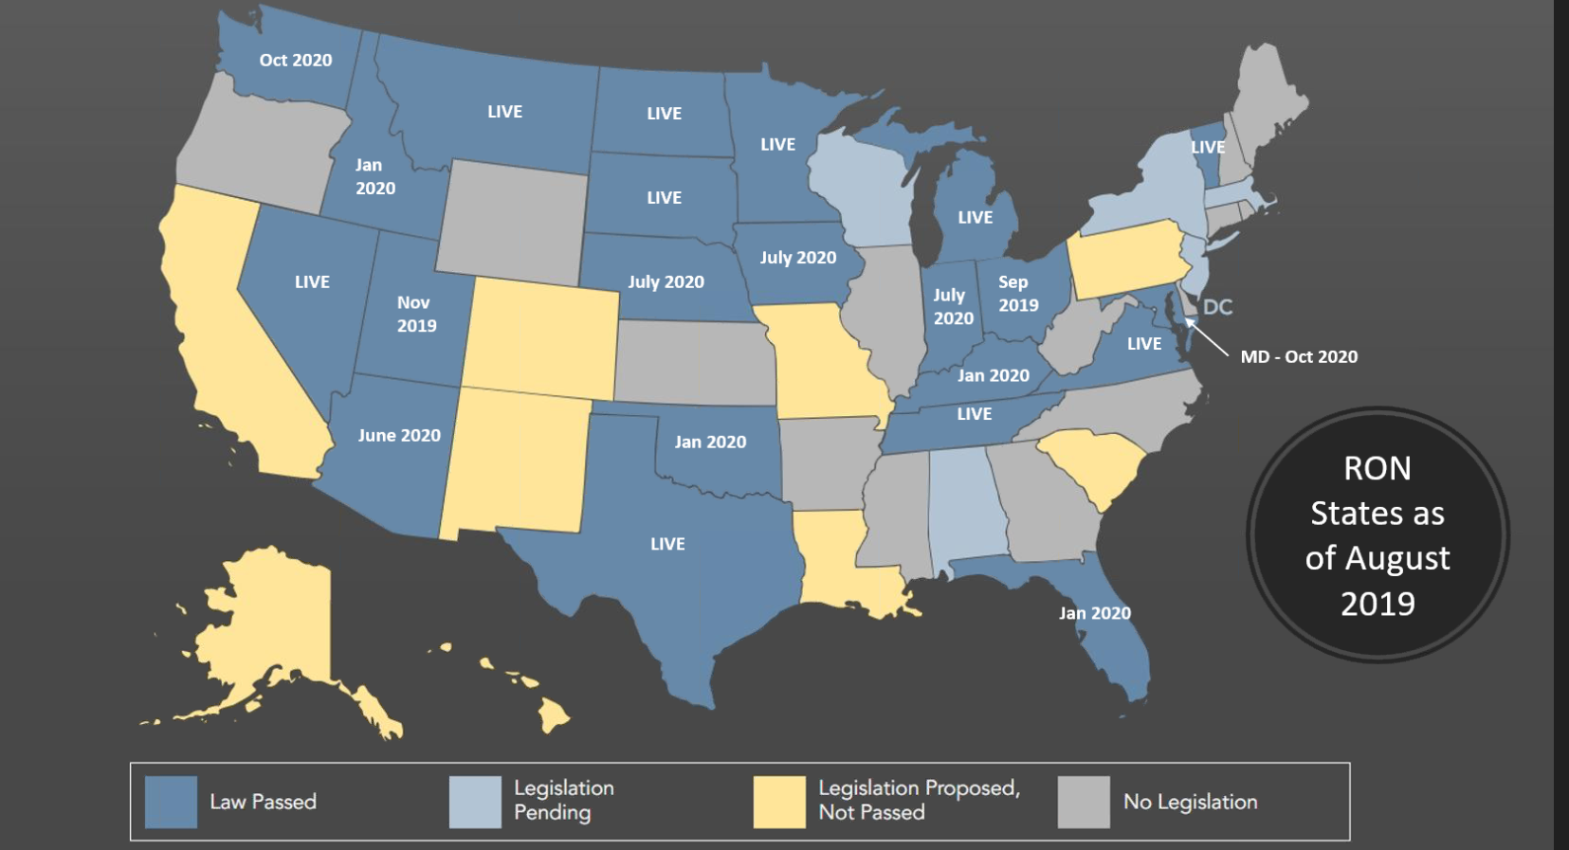
RON States as of August 2019

Slide 13
Texas
Enacted 2017, effective July 1, 2018
Notary physically present in Texas
Identity established by both credential analysis and knowledge-based authentication
Audio/visual record
Notary seal indicates that remote notary procedure used

Slide 14
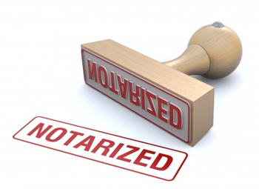
Key Principles from NASS Standards, MBA-ALTA Model & RULONA (2018)
Technology Neutrality as to means of eNotarization and authentication processes
Mandatory Disclosure in the notarial certificate
Multifactor Authentication to identify signer
Robust Audit Trail including audio-video recording
Notary Located in State at time of notarial act
©2018 First American Financial Corporation and/or its affiliates. All rights reserved. NYSE: FAF

Slide 15

Multifactor Authentication in
RULONA (2018)
“… at least two different types of Identity Proofing processes or services.”
©2018 First American Financial Corporation and/or its affiliates. All rights reserved. NYSE: FAF

Slide 16
General Principles – ALTA
  Adequate safeguards to protect against identity thieves, forgery and fraud.
  Multi-factor identification of the signer.
  Recordability in local land records, regardless of the capability to receive electronic recordings.
  A determination of whether the state will recognize remote notarial acts performed by out-of-state notaries and whether such acts are governed by the state.
  An indication the document was notarized remotely online.
  Tamper-evident technology used.
  Retention of records for a period of at least 7 years.
  Clarity and consistency within the statutes.

Slide 17
2019 Washington Law
Based on 2018 amendments to RULONA
Senate Bill 5641
Chapter 154, Laws of 2019
Code Reviser has added new sections to Revised Code of Washington – current law shown side-by-side with sections taking effect October 1, 2020

Slide 18
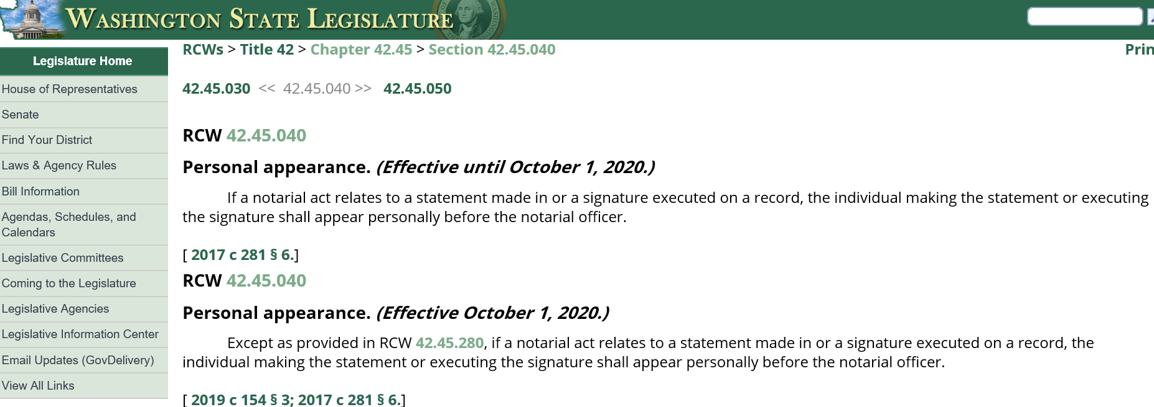
RCW 42.25.040 – Personal Appearance

Slide 19
RCW 42.45.280 – RON (sort of)
“Electronic Records Notary Public”
Definitions
Notary licensed and located in Washington may use procedures in section to take acknowledgments and notarize documents for a “remotely located individual” anywhere in the world using “communication technology”

Slide 20
RCW 42.45.280 – RON Provisions
Identity proofing is process by which third party provides notary with “means to verify the [signer’s] identity . . . by a review of personal information from public or private data sources.”
Identity must be verified “by using at least two different types of identity proofing[.]”
Retention of audio-visual record for 10 years

Slide 21
RCW 42.45.020
New subsection:
(3) A notarial officer may certify that a tangible copy of an electronic record is an accurate copy of the electronic record.
Allows for “papering out”

Slide 22
RCW 65.08.030 - Current
“Recorded Irregular Instrument Imparts Notice”
Recorded instrument conveying or encumbering real property
Execution or acknowledgment not compliant with law
Imparts same constructive notice to third persons as if had been properly executed, acknowledged, and recorded

Slide 23
RCW 65.08.030 – New Subsection
Tangible copy of electronic record conveying or encumbering real property
Recorded with auditor
Tangible copy not certified in compliance with RCW 42.45.020(3)
Imparts same constructive notice to third persons as if the tangible copy had been appropriately certifed

Slide 24
RCW 65.08.070 - Current
“Real Property Conveyances to be Recorded”
Conveyance, when acknowledged by signer and certified by person authorized to take acknowledgments, may be recorded
Unrecorded conveyance void against
  subsequent purchaser/mortgagee
  in good faith and for consideration
  whose interest is recorded first

Slide 25
RCW 65.08.070 – New Subsection
Auditor may accept for recording
  Document that is tangible copy of electronic record
  Certified by notary as accurate copy of electronic record pursuant to RCW 42.45.020(3)
Document meeting these criteria satisfies any requirement for an original document

Slide 26
RCW 42.45.280 - Rulemaking
Rules adopted by Department of Licensing may:
(a) Prescribe the means of performing a notarial act involving a remotely located individual using communication technology;
(b) Establish standards for communication technology and identity proofing;
(c) Establish requirements or procedures to approve providers of communication technology and the process of identity proofing; and
(d) Establish standards and a period for the retention of an audio-visual recording created under subsection (3)(c) of this section.

Slide 27
RCW 42.45.280 - Rulemaking
(9) Before adopting, amending, or repealing a rule governing performance of a notarial act with respect to a remotely located individual, the director must consider:
(a) The most recent standards regarding the performance of a notarial act with respect to a remotely located individual adopted by national standard-setting organizations and the recommendations of the national association of secretaries of state;
(b) Standards, practices, and customs of other jurisdictions that have laws substantially similar to this section; and
(c) The views of governmental officials and entities and other interested persons.

Slide 28
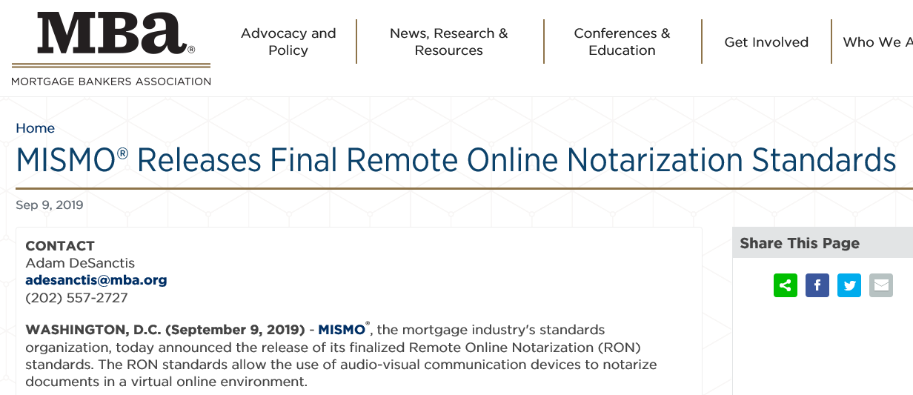
Mortgage Industry Standards Maintenance Organization - MISMO

Slide 29
MISMO – Credential analysis
Credential analysis
  Notary must be able to compare ID photo with appearance of signer
  Capture necessary portion of ID such as both front and back of driver’s license
  Evaluation of validity of credential to be done by provider, not notary
  Capability to detect fraudulent credentials and inappropriately modified ones

Slide 30
MISMO – KBA
Knowledge-based authentication
Five questions
  At least five possible answers per question
  Require at least four questions answered correctly
  Question process limited to two minutes
Retests
  Up to two within 48 hours, replacing at least two the five questions each time

Slide 31
MISMO – KBA
Confidentiality
  KBA element may not be included in
    Video recording
    Part of person-to-person video interaction between notary and signer
  System provider may not store KBA info
  Notary gets score only

Slide 32
MISMO – Biometrics
Facial, fingerprint, voice recognition
“Have potential application to” RON
But
  “MISMO does not offer specific guidance in applying this type of authentication protocol due to the lack of available industry standards regarding biometric technology.”

Slide 33
Electronic Signatures in Washington
Electronic Authentication Act repealed by House Bill 1908
As of July 28, 2019, Washington is the only stated without a state electronic signature law
47 states have adopted the Uniform Electronic Transactions Act; NY and IL have local versions

Slide 34
Electronic Signatures in Washington
What about the federal ESIGN Act?
15 USC §7001(a)
Applies to “any transaction in or affecting interstate or foreign commerce[.]”
©2018 First American Financial Corporation and/or its affiliates. All rights reserved. NYSE: FAF
Notes:
any transaction in or affecting interstate or foreign commerce

Slide 35
Electronic Signatures in Washington
Interstate commerce connection
Deeds of trust to secure loans
Where’s the commerce connection with:
Deeds to establish community property
Transfer on death deeds
Deeds to resolve boundary disputes
©2018 First American Financial Corporation and/or its affiliates. All rights reserved. NYSE: FAF
Notes:
any transaction in or affecting interstate or foreign commerce

Slide 36
RON – What you need to know
Difference between RON and traditional notarization
Difference between RON and electronic notarization
When RON takes effect in Washington
Multifactor identification
  Knowledge based, Credential analysis, Biometric
RON and the recording laws
Electronic signatures in Washington
The acronyms: RON, RULONA, UETA, ESIGN
©2018 First American Financial Corporation and/or its affiliates. All rights reserved. NYSE: FAF

Slide 37

Questions?
          Sean Holland
          Regional Underwriting Counsel
          First American Title
          sholland@firstam.com
©2018 First American Financial Corporation and/or its affiliates. All rights reserved. NYSE: FAF

