Slide 1
Payroll – SB 5021, payroll items 2021 ARPA
Panel Discussion – Michelle Novak, Payroll Manager San Juan County

Slide 2
Senate Bill 5021
Passed in Senate and in House
This bill will give public employees full credit for hours/wages if reduced during the COVID-19 crisis.
including employees participating in a shared work program.

Slide 3
In short, the bill ensures that public employee’s retirements will not be affected by Covid-19 work reductions.
Past Furloughs:
Following the 2009 recession, Legislation enacted Senate Bill 6157 and House Bill 2070
Providing that the average final compensation includes any compensation that was forgone by the member during the 2009-2013 fiscal periods, as a result of the employers’ efforts to reduce expenditures.
DRS has been requesting information for these prior year furloughs, so it is highly recommended to keep good records of reductions in pay.
Furlough tracking:

Slide 4
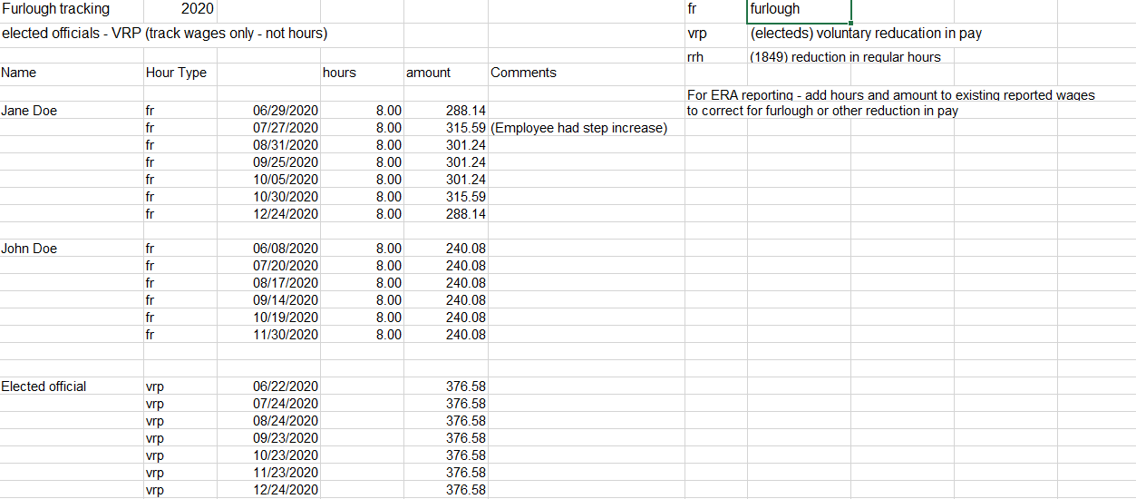
Example of Tracking spreadsheet – track pay period, hours and wages of reductions. This will make it easier to complete the VOE form from DRS. Do not delete this information. DRS can ask for this years down the road.

Slide 5
Reporting to DRS
Hours and wages are reported in the pay period earned.
DRS will send the employer an RFI (Request for information) from the ERA website (Employer Reporting Application) asking for information on any reduction of hours/wages
Usually, the RFI is requested when an employee is close to retirement and they informed DRS of a mandatory furlough or reduction in wages/hours
The RFI will include an electronic verification form that needs to be completed for the pay periods in which the reduction occurred. Currently, the format still reads from 2009-2013, and DRS will need to update it with the years stated in 5021.
To complete the Verification of Expenditure (VOE) form correctly, you will need to report the full wage and hours that would have been paid, as if the employee did not have the reduction in pay. (from tracking report)

Slide 6
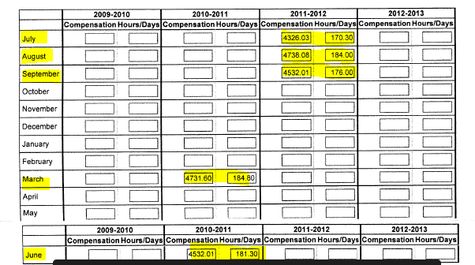
Verification of Expenditure form (VOE) on the ERA website:
Example:
During the 2011, Jane Doe participated in mandatory furloughs. The employer originally reported for March earnings of $4531.60 and 176.8 hours (total salary reduction of $200.00). The correct entry for the VOE report is $4731.60 and 184.80 hours which now makes the employee “whole” for March. Be sure to report all months with reductions on the VOE report.
Be very careful to enter the wages and hours in the correct month and year.
This layout can be confusing, and it is easy to make mistakes.

Slide 7
Be very careful to enter the wages and hours in the correct month and year of VOE.
Earnings for the employee can be found under the “Member Management” section of the DRS Employer portal.

Slide 8
ARPA (American Rescue Plan Act) – payroll changes/ Cobra
Paid Leave
While the ARPA does not require employers to provide paid leave for employee absences related to COVID-19.
As of April 1, 2021, employers may voluntarily offer another 10 days of paid sick leave to employees.
The first two weeks of EFMLA may now be paid at 2/3 the regular rate of pay (previously unpaid)
Cobra
From April through September 2021, free COBRA coverage is available for employees (and their covered family members) who lost group health insurance due to an involuntary termination or reduction in hours due to the pandemic. Does not apply to those who voluntarily quit employment.
For more information regarding ARPA, please go to the link below:
https://www.congress.gov/bill/117th-congress/house-bill/1319/text

